Slide 1

Student Orientation (Grades K-8)
Notes:
2021-2022

Slide 2
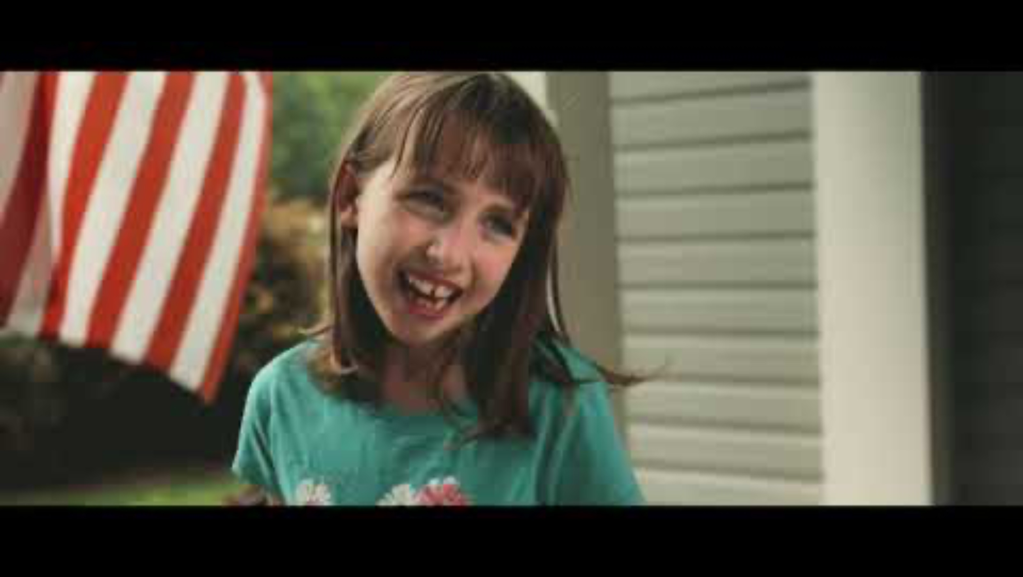
PFE Goals
To ease isolation and loneliness in older adults by providing opportunities for connection and friendship with a young person.
For students to receive mentorship from an older adult and experience the blessing of service.
To support students (and their families) who are attending SDA schools by helping them earn scholarship.

Slide 3
PFE Basics
Attend orientation (every year)
Set up your online account
Start visitation
  1 hour/week
  Can visit from August-May (after orientation)
  At or around your mentor’s home
  Parent/guardian must be present to supervise
Submit an online reflection after each visit (within 24 hours)
You receive:
$30 scholarship per visit
The blessing of an intergenerational friendship

Slide 4
Choosing Your Mentor
An appropriate mentor is a cognitively healthy, older adult (age 55+) or someone with a disability who could use company and/or light assistance around the home.
Find a mentor:
With whom you can form a friendship
Who might be lonely or like company
Who might have similar interests or hobbies
Who can commit to one hour, once per week for the school year.
*No relatives or nursing home residents

Slide 5
Creating Your Account
Go to pfe.sffcfoundation.org - bookmark this page
Click "Student Application"
Complete the application (must have your mentor’s information before applying)
Once your school coordinator approves your account, you will receive an email prompting you to complete account creation by selecting a password.
Follow the link and choose your password.
Log in
Complete Entry Student Survey (on your PFE dashboard)

Slide 6
Visiting
Once you have attended orientation and set up your online account, start visiting!
We recommend planning your visits with your mentor by filling in the PFE Calendar.
In the event of a missed visit:
Communicate with your coordinator
You can choose to miss that week of scholarship OR make up the visit
Only one make-up visit is allowed per month
Make-up visits may not be attached to another visit
  They must be on a separate day than your regular visit

Slide 7
Activity Ideas
Help with chores
Bake/cook
Crafts and art
Tell stories
Play games
Work on a puzzle
Interview each other
Make a recipe book
Exercise/go on a walk
Gardening
Read a book together/devotional/Bible
Sidewalk/driveway chalk
Singing

Slide 8
Unacceptable Activities/Visits
Virtual visits (Zoom, phone calls)
Visits occurring on Saturdays
Going to an event together
Watching TV/movies
Time without a parent present to supervise
Visits with another adult/mentor because yours is unavailable

Slide 9
Reflections
You are required to submit a reflection after each weekly visit within 24 hours.
Tips
Submit in your car before going home or right when you get home
Reflection Requirements
K-3rd grade required to write a minimum of 3 sentences
Submit with your mentor the last 5 minutes of your visit
4-8th grade required to write a minimum of 5 sentences
Must answer the following questions EACH week -
What activities or service did you do with your mentor?
What did you talk about during your visit?
What did you learn from/about your mentor OR what did you share/teach them about yourself?
Should be written in student’s words. Write from the heart! Younger kids can dictate to someone helping them (parent or older sibling).
Reflections that do not meet the above requirements will be rejected and must be fixed/resubmitted within 4 days.

Slide 10
Reflection Examples
Good
“Today I made Raisin Ribbon Bars with some help from Miss Barbara. We used a nut chopper that was seventy years old. The bars turned out good. While we worked, we talked about what it was like for her growing up in the Philippines as a little girl. Those stories make me want to go there some day. I told her about my trip to Mexico a few weeks ago and laughed about the squirrel who chased me. It was a nice visit.”
“This week, Miss Jane and I decided to do outdoor activities. We started by watering her garden and then she sprayed me on accident! We laughed until we cried. After that, we went for a walk and talked about her grandchildren that live far away. I also told her about my week at school and the A+ I got on my test. She said she was proud of me.”
“Mr. Gregory and I worked on his lawnmower for this visit. He told me stories about when he was in the army, and I told him that I want to be a firefighter when I grow up. He said that I can do anything I put my mind to and that he’ll be rooting for me. I can’t wait for next visit because he’s going to show me his old army uniform.”
Bad
“We went to the park. I saw a rabbit. It was fun.”
“We baked cookies. They were yummy. We hugged. We went home.”
“I folded laundry at Miss Sheila’s house. There was a lot of laundry. I was so tired when I was done.”
“Amy picked me up from school today because my mom was still at work. We talked on the drive home and then watered her garden until mom came to get me.”

Slide 11
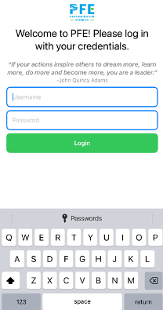
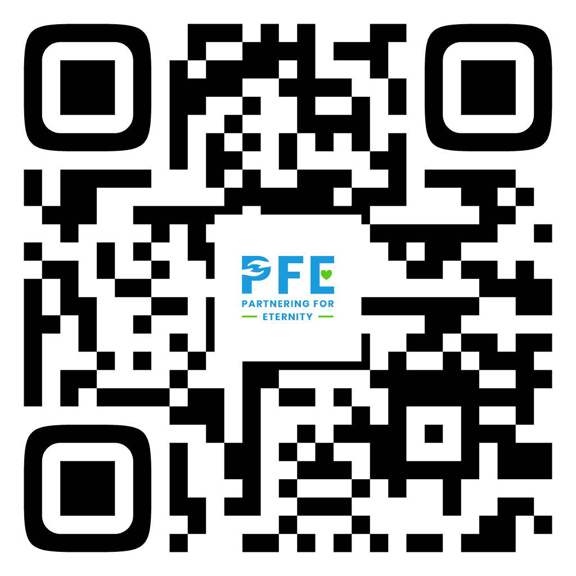
NEW - PFE Student App
App for iOS
Coming soon on Android

Slide 12
Contact Information
PFE Coordinator
Name:
Phone:
Email:

